Slide 1
Internationalization & Accessibility
Presented by: Khai Phan, Tyrell Unser, Bowei Yao, Chenming Xu, Chaoyi Wu, Mamadou Diallo

Slide 2

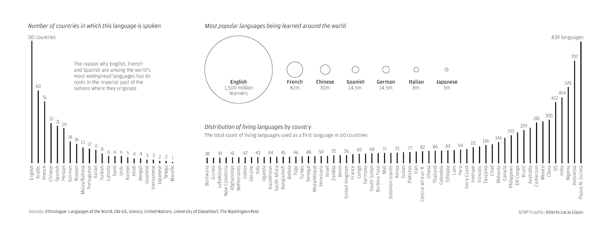
Localization (Khai P.)

Slide 3

Localization (Khai P.)

Slide 4

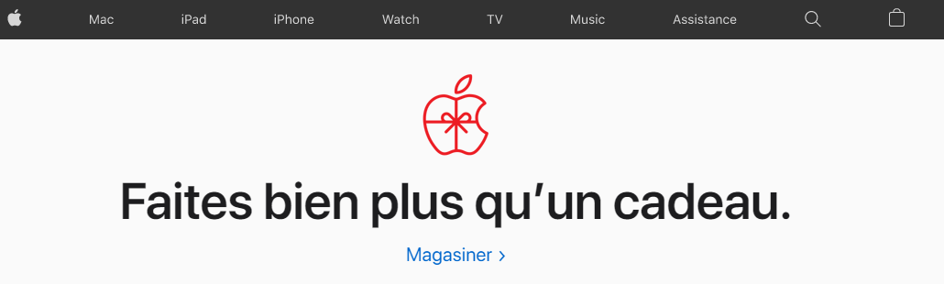
Localization (Khai P.)

Slide 5

Localization (Khai P.)

Slide 6
2. Cultural Differences
Power Differences
Individualism
Gender Roles
Uncertainty Avoidance
Long term orientation (versus short term)

Slide 7
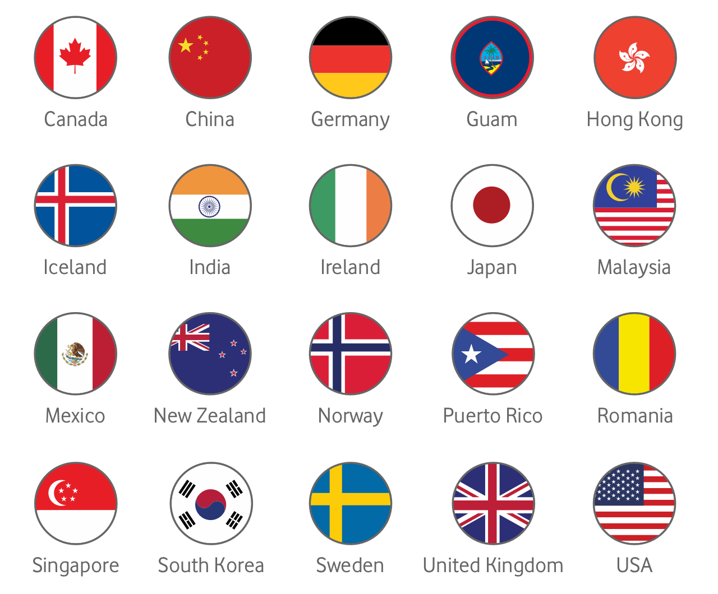
2. Cultural Differences
Power Differences

Slide 8


2. Cultural Differences
Individualism

Slide 9

2. Cultural Differences
Gender roles

Slide 10

2. Cultural Differences
Uncertainty avoidance

Slide 11

2. Cultural Differences
Long term orientation

Slide 12
3. Writing Text
Use simple English
The latter of the two was deluged in a plethora of roses.
The second [one] was covered in [many] roses.
Use a Noun-Verb-Object structure

Slide 13
3. Writing Text
Avoid abbreviations/acronyms
NDH
EST
GmbH
ASAP
ETC.
HBF
HDR
Avoid local Jargon
Avoid if non universal
Original words can still be used
Disk drive
Download

Slide 14


3. Writing Text
English:
Gift = Present
Deutsch:
Das Gift = Poison
Das Geschenk = Present

Slide 15
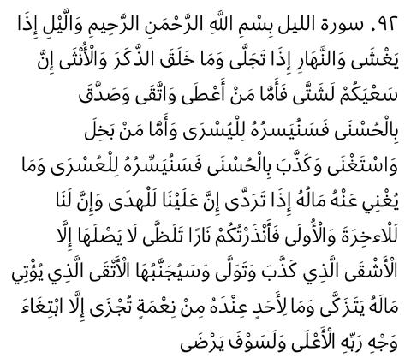
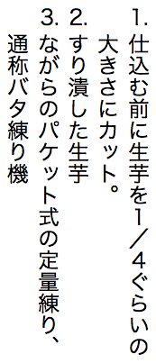
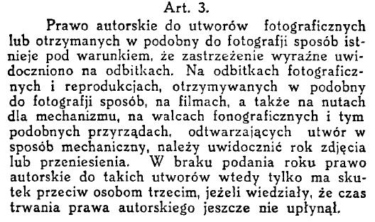
3. Writing Text

Slide 16






4. Images and Symbols
ISO Symbols
Exit
First Aid
Restaurant
No Smoking
Telephone
Toxic

Slide 17
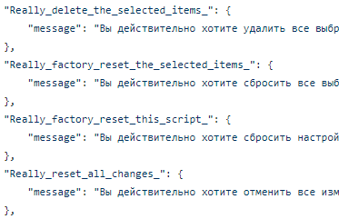
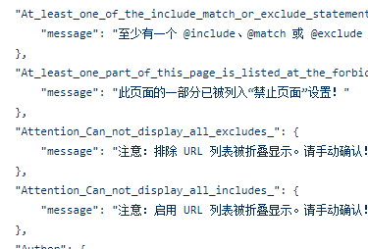
4. Images and Symbols
Locale & Translation

Slide 18

4. Images and Symbols
Avoid Ambiguity
English?
French?

Slide 19


4. Images and Symbols
Thumb up Sign

Slide 20


4. Images and Symbols
Checkmark vs Cross

Slide 21

5. Types of Disabilities
Accessibility:
a system must be designed to be usable by an almost unlimited range of people, essentially anyone who desires to use it
8% of web users have a disability that makes browsing the websites traditionally impossible

Slide 22
5. Types of Disabilities
Visual
reduced visual acuity to total blindness
Hearing
inability to detect certain sounds to total deafness
Physical movement
inability to perform certain tasks e.g. moving a mouse, pressing two keys at the same time
speech or language
difficulty to read or write e.g. dyslexia
Cognitive
memory impairment and perceptual problems
seizure disorder
sensitive to visual flash rates

Slide 23
6. Designing for Accessibility (Chaoyi W.)
Accessibilities issues must be considered during all stages of development
Retrofitting results in waste of time and effort
Compatibility with accessibility utilities
Notes:
https://uxdesign.cc/designing-for-accessibility-is-not-that-hard-c04cc4779d94

Slide 24
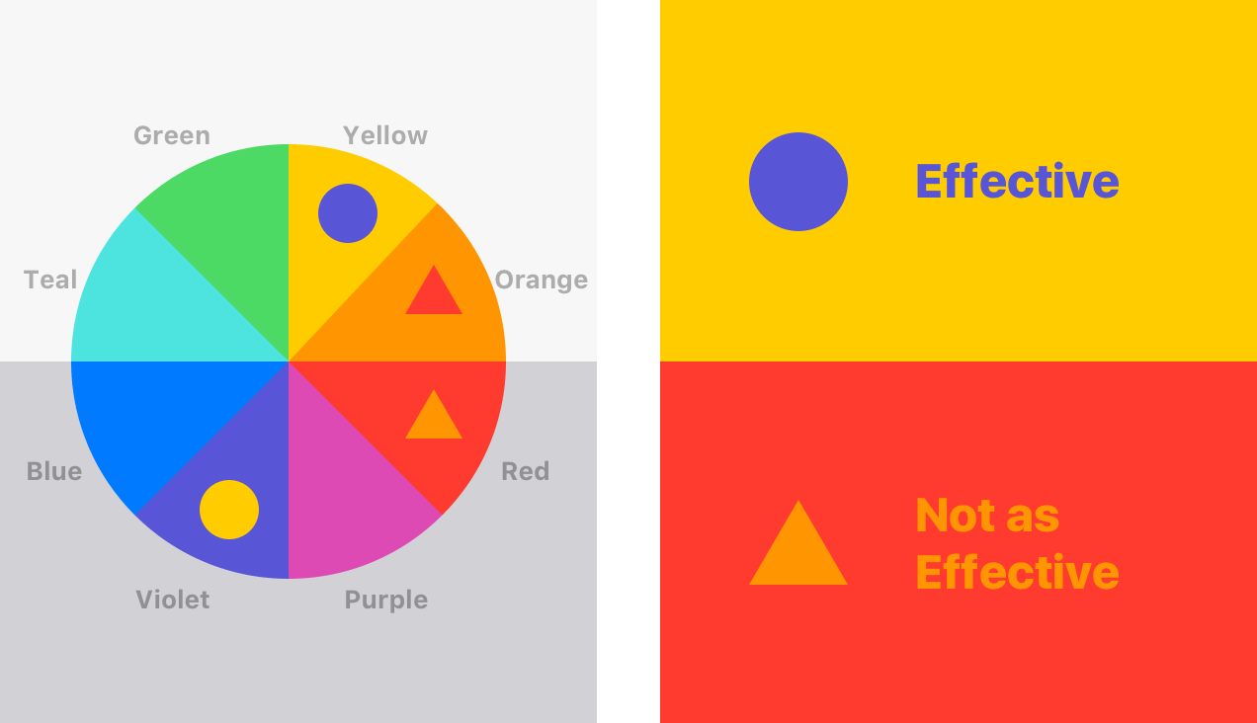
6. Designing for Accessibility
For Visual Disabilities
Compatibility with screen-reader programs & screen-enlargement utilities
Meaningful captions, labels, and window titles
Offer a variety of colour schemes
Don’t use ONLY colours as an indicator
Notes:
https://www.smashingmagazine.com/2017/10/nailing-accessibility-design/

Slide 25
6. Designing for Accessibility
For Physical Disabilities
support voice input
support both keyboard-only and mouse-only control
precise mouse movements should not be required
Notes:
https://webdesign.tutsplus.com/articles/keyboard-accessibility-tips-using-html-and-css--cms-31966

Slide 26
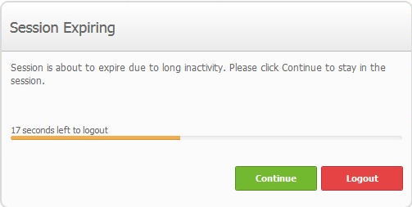
6. Designing for Accessibility
For Speech/Language Disabilities
spell-check function
limit the use of time-based interfaces

Slide 27

6. Designing for Accessibility
Photosensitive epilepsy
refrain from using elements that blink or flicker
Either avoid using flashing contents or provide an option to turn it off
Reduce contrast in flashing content

Slide 28
THE END

